Slide 1
Managerial Economics and
Organizational Architecture Chapter 6: Market Structure

Slide 2
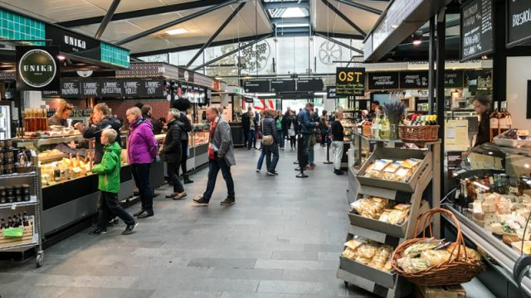
Market Structure
A market consists of;
All firms and individuals willing and able to buy or sell a particular product
A market structure is;
Defined by attributes of the market environment
Kilde: https://www.nordicexperience.com/tours/copenhagen-tours/best-copenhagen-tour-torvehallerne-market-visit/
2

Slide 3
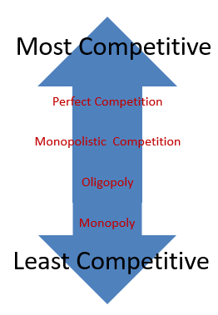
Market Structure
Perfect competition
Monopoly
Monopolistic competition
Oligopoly
Kilde: https://www.reviewecon.com/4-market-structures1
3

Slide 4
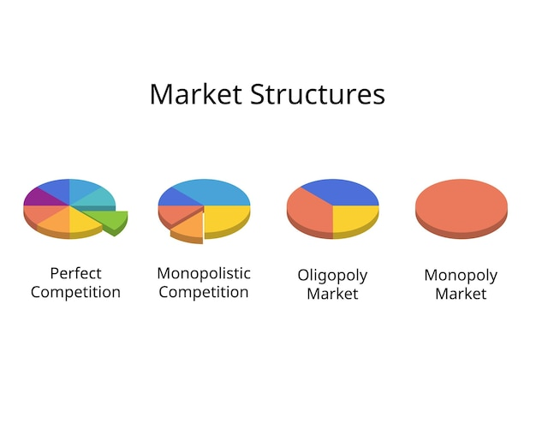
Perfect Competition Characteristics
Many buyers and sellers
Product homogeneity
Low cost and accurate information
Free entry and exit
Best regarded as a benchmark
Kilde: https://www.freepik.com/premium-vector/market-structures-perfect-competition-monopoly-monopolistic-competition-oligopoly_137102145.htm
4

Slide 5
Firm Demand Curve Perfect Competition
$
$
S
P*
P*
D_{i} = MR_{i} = AR_{i}
Price (in dollars)
D
Q
Q_{i}
Quantity (market)
Quantity (firm i)
5

Slide 6
Firm Supply
Short run
Marginal cost curve above average variable cost
Long run
Long-run marginal cost curve above long-run average cost
6

Slide 7
The Firm’s Short-Run Supply Curve
$
ATC_{i}
SRMC_{i}
AVC_{i}
Costs per unit of output (in dollars)
Q_{i}
Quantity (firm i)
7

Slide 8
Competitive Equilibrium
Profit? => If yes - entry => S increases => P decreases
$
$
LRMC_{i}
LRAC_{i}
S₀
P*₀
P*₀
Price and cost per unit of output (in dollars)
S₁
P*₁
P*₁
D₀
Q_{i}
Q
Q*_{i1}
Q*_{i0}
Q*₀
Q*₁
Quantity (firm i)
Quantity
8

Slide 9
Monopoly
Single seller in an industry
Strong barriers to entry
Profit maximization
faces market demand and sets MR = MC
Unexploited gains from trade
Kilde: https://www.freepik.com/premium-vector/market-structures-perfect-competition-monopoly-monopolistic-competition-oligopoly_137102145.htm
9

Slide 10
Monopolist Faces Market Demand
$
Profits
P*=
105
Price and cost per unit of output
Lost gains
from trade
MC = AC
D
Q
Q*=95
MR
Quantity
10

Slide 11
Oligopoly
A few firms produce most market output
Products may or may not be differentiated
Effective entry barriers protect firm profitability
Firm interdependence requires strategic thinking
Examples – steel, autos, colas, airlines
Kilde: https://www.freepik.com/premium-vector/market-structures-perfect-competition-monopoly-monopolistic-competition-oligopoly_137102145.htm
11

Slide 12
The Nash Equilibrium
An oligopolist does the best it can, given expectations of rival behavior
Behaviors are noncooperative
Duopolists considering to put a low price, or a high price must consider rival’s response
A Nash equilibrium occurs when each firm does the best it can given rival’s actions – no change in strategy can improve a situation.
12

Slide 13
Determining the Nash Equilibrium
Low
Price
TuInc
High
Price
$20
$40
Tallene indicerer her payoff/benefits
Low
Price
$40
$0
WonCo
$200
$400
High
Price
$250
$200
13

Slide 14
The Cournot Model
Duopolists A and B face industry demand
P = 100-Q, Q = Q_{A}+Q_{B}
Each firm takes the other’s output as fixed, and then decides how much to produce!
E.g., P_{A} = (100-Q_{B}*)-Q_{A}
Marginal revenue for A is
MR_{A} = (100-Q_{B}*)-2Q_{A}
If MC = 0, the optimal output for A for the given output for B is
(1) Q_{A} = 50 - 0,5Q_{B}
(2) Q_{B} = 50 - 0,5Q_{A}
..which is the reaction curve for firm A (henholdsvis B)
Lign. 2 ind i lign 1, isolér => Q = 33,33
14

Slide 15
Cournot Equilibrium
Q_{B}
100
Firm A’s reaction curve
a = Competitive equilibrium, QFK=100
b = Cournot equilibrium, QC=66,67
c = Collusive (monopoly) equilibrium, QM=50
Quantity of output by Firm B
50
a
33.33
b
Bemærk akserne!
25
c
Firm B’s reaction curve
Q_{A}
25
33.33
50
100
Quantity of output by Firm A
15

Slide 16
Comparison of Prices and Output and Profits Among Different Equilibria – The Industry
$
100
50
Collusion
Price (in dollars)
33.34
Cournot
Bemærk akserne!
MC = 0
Competition
0
Q
50
66.66
100
MR
16
Quantity

Slide 17
The Classic Prisoners’ Dilemma
Bea
2 months
18 months
Avi—No confession
Avi—No confession
Tallene indicerer her costs/’bads’
2 months
0 months
Bea—No confession
Bea—Confession
Avi
0 months
12 months
Avi—Confession
Avi—Confession
18 months
12 months
Bea—No confession
Bea—Confession
17

Slide 18

Cartels
Occur when firms agree to set price and output levels (and are acting as a monopoly)
Generally illegal in the U.S. and the EU
Self interest results in failure of the cartel
Repeated interaction increase the incentives to cooperate
Kilde: https://www.aeaweb.org/research/uncovering-number-of-cartels-finland
18

Slide 19
The Cartel’s Dilemma
Bea
$500
$150
Tallene indicerer her payoff/benefits
AVInc—Low output
AVInc—Low output
$500
$600
BeaCo—Low output
BeaCo—High output
AVI
Ramme p. 213n. & 214ø.
$600
$200
AVInc—High output
AVInc—High output
$150
$200
BeaCo—Low output
BeaCo—High output
19

